Slide 1

Taste Tracker
Chase Lahner, Rory McCann, Ivan Puri

Slide 2
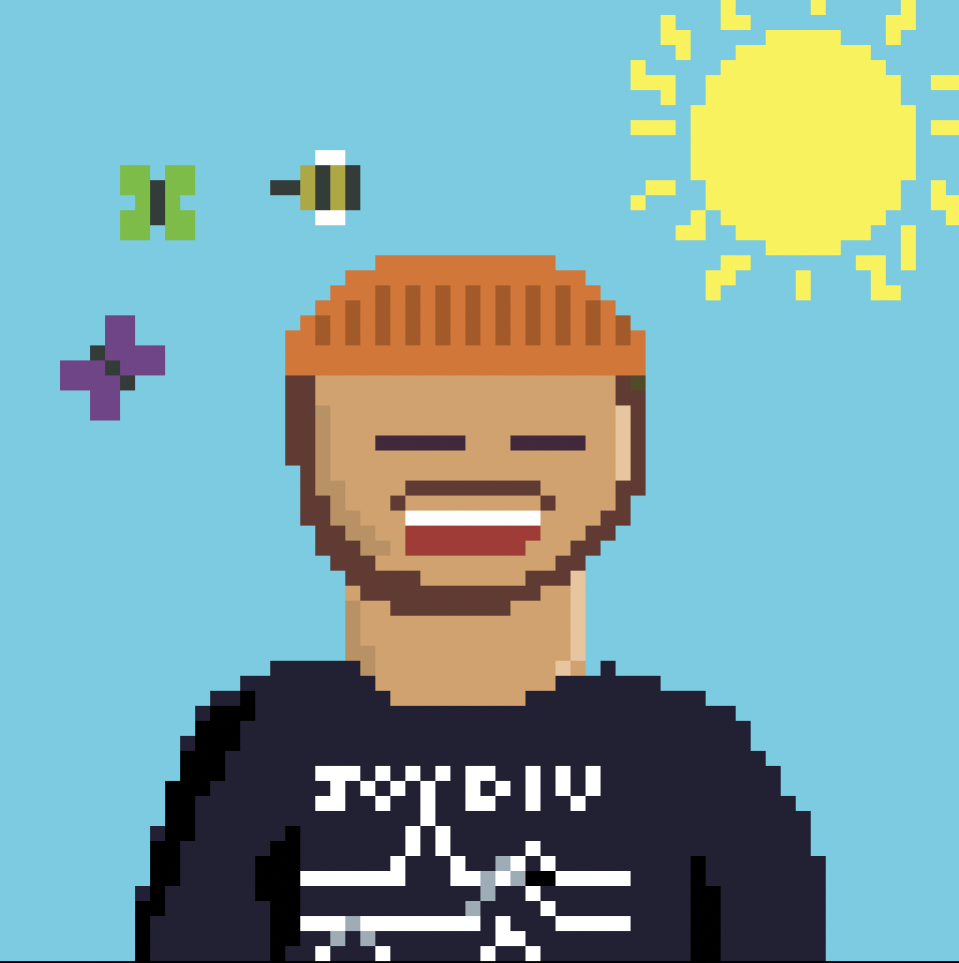
Inspiration
We love music, and even more than that, we love to judge each others taste
Spotify API readily available
Hugging Face LLM experience

Slide 3

Process
We first needed to decide on a tech stack
We ended up gravitating towards python to be able to use hugchat, an API for Hugging Face
This led us to use Flask and Spotipy in conjunction with hugchat to create our framework
Logic was done last night, today was spent making the site
Custom sprites using Aesprite

Slide 4


Slide 5

Favorite Quotes
“Now, I wouldn’t be Ringo if I didn’t mention one thing – where’s all the drums at? Come on, people, let’s get those percussion sections pumping!” – Ringo Starr
”While some may argue that this mix leans slightly towards mainstream appeal due to certain inclusions (*cough* Party in the USA *cough*)..”- Radio Girl
“Silence falls upon the night as Batman casts his gaze upon the list before him” – Batman

Slide 6

Next Steps
Refine the look of the site
Create more characters to judge your taste
We hoped to deploy, but did not have enough time
Increase efficiency
Inconsistency in Hug Chat responses
Wanted to have Letterboxd and Goodreads for more media analysis, but the APIs were inaccessible

Slide 7
Next Steps
Refine the site
Create more pages and refine the ones we have
Make another few judges
Sprites took some time, we have no experienced artists
Decrease Latency
Find ways to increase performance
Deploy the app

